Slide 1
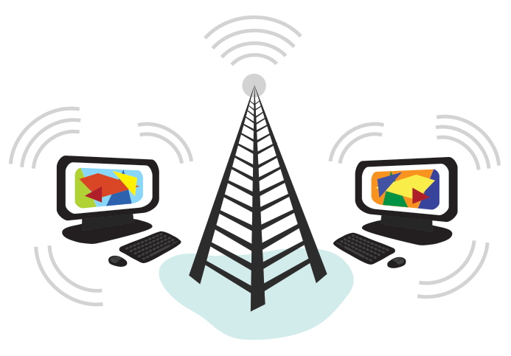
CSE101 Intro to CS and Programming
Internet
Lecture 13 (Week 7)
By Mr. Faheem Shaukat
faheem@iqraisb.edu.pk
www.tinyurl.com/IUICLectures

Slide 2
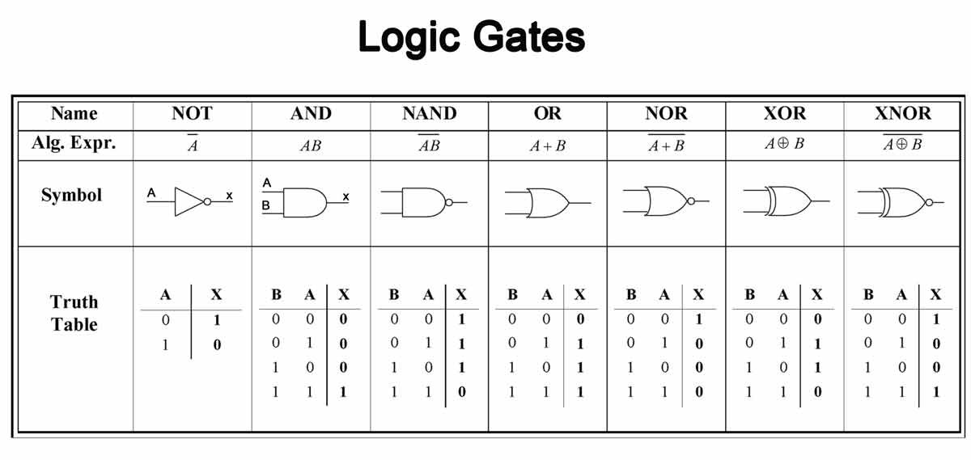
Repeat of Week 4 Lecture 8

Slide 3
Finding Boolean Expression
of a Logic Circuit (Example 2)
Computer Fundamentals: Pradeep K. Sinha & Priti Sinha
OR
A B
A + B
C=(A +B)⋅(A⋅ B)
A ⋅B
A⋅B
AND
AND
NOT
81

Slide 4
Constructing a Logic Circuit from a Boolean Expression (Example 1)
Computer Fundamentals: Pradeep K. Sinha & Priti Sinha
Boolean Expression =
A ⋅B +C
83

Slide 5
AND
A B
A ⋅B
A ⋅B +C
C
OR

Slide 6
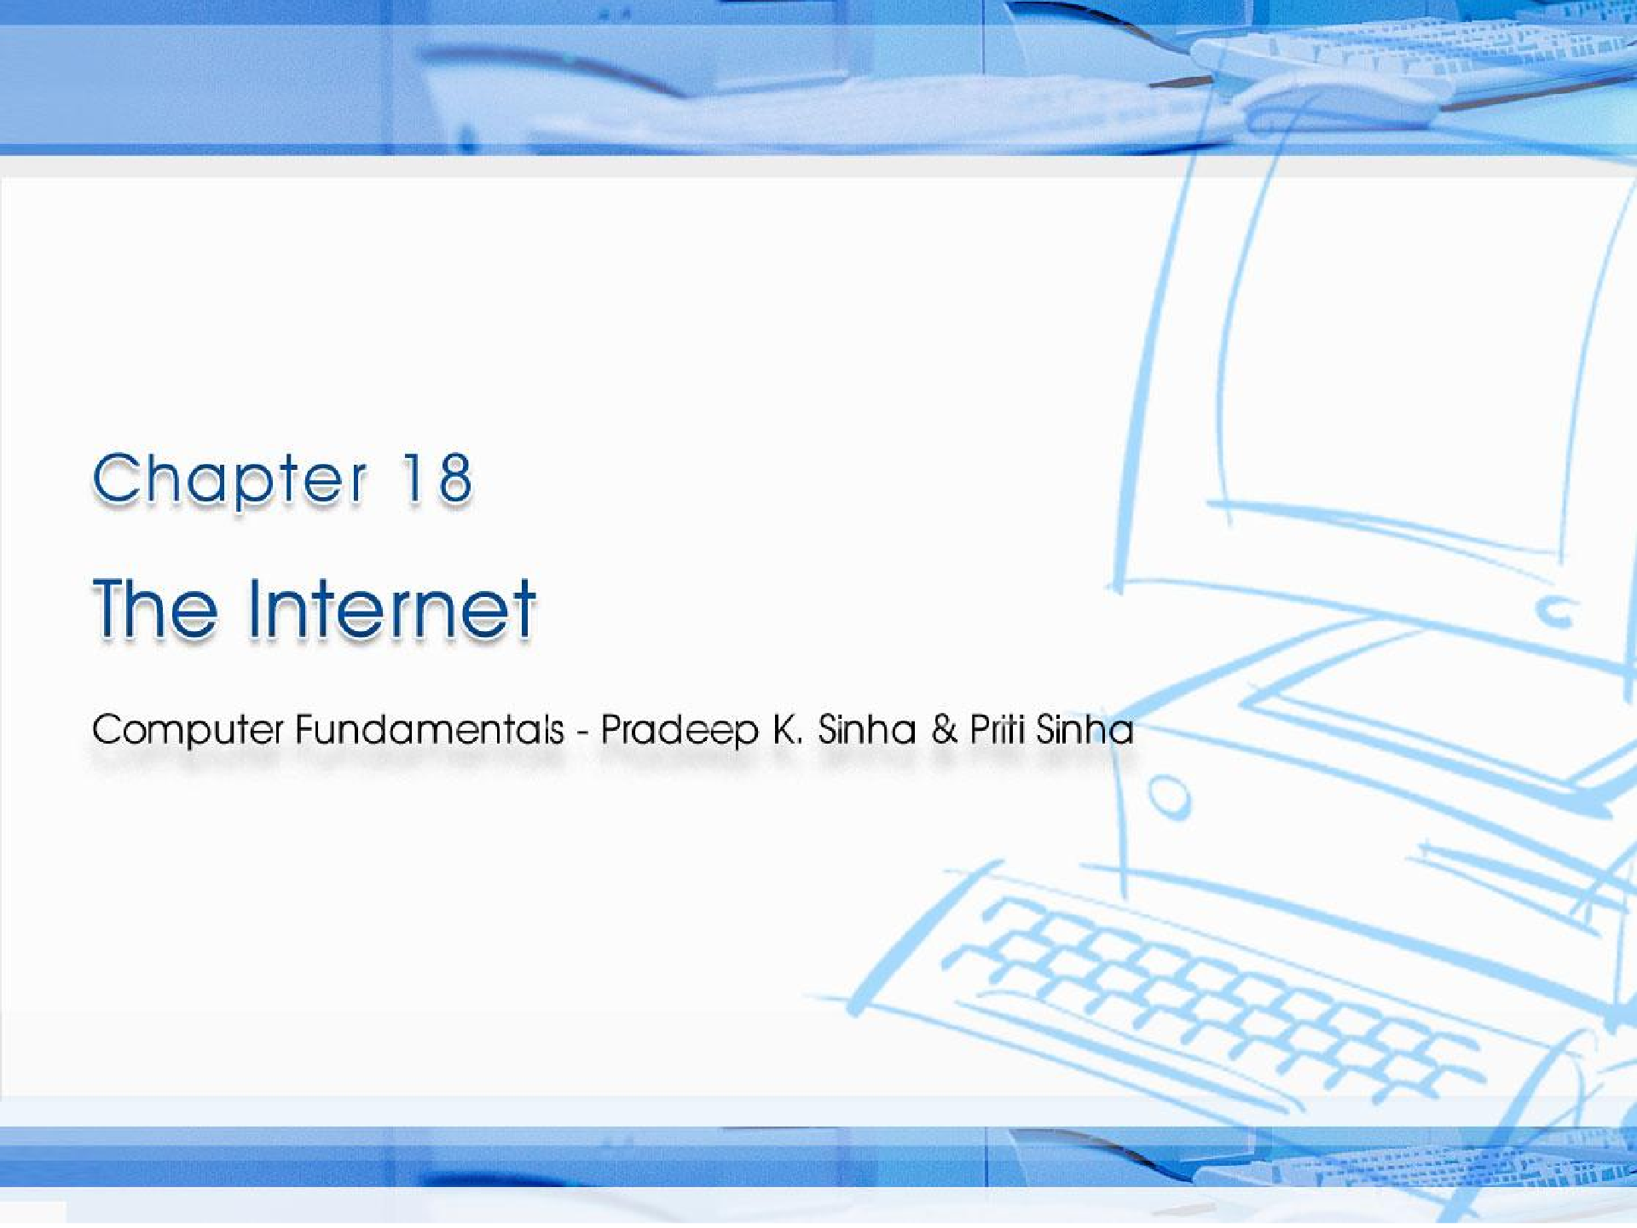

CCoommppuutterer FFununddaammenenttaallss:: PPrradadeeepep KK.. SSiinhanha && PPrriititi SSiinhanha
Ref. Page Chapter 18: The Internet Slide 1/16

Slide 7
Learning Objectives
Computer Fundamentals: Pradeep K. Sinha & Priti Sinha
In this chapter you will learn about:
Basic services on Internet
World Wide Web (WWW)
WWW browsers
Uses of the Internet
Ref. Page 358

Slide 8
Basic Services of the Internet
Computer Fundamentals: Pradeep K. Sinha & Priti Sinha
Electronic Mail (e-mail): Allows user to send a mail (message) to another Internet user in any part of the world in a near-real-time manner
File Transfer Protocol (FTP): Allows user to move a file from one computer to another on the Internet
Telnet: Allows user to log in to another computer somewhere on the Internet
Ref. Page 359

Slide 9
World Wide Web (WWW or W3)
Computer Fundamentals: Pradeep K. Sinha & Priti Sinha
Hypertext documents on the Internet are known as web pages
Web pages are created by using a special language called HyperText Markup Language (HTML)
WWW uses the client-server model and an Internet Protocol called HyperText Transport Protocol (HTTP) for interaction among the computers on the Internet
Any computer on the Internet that uses the HTTP protocol is called a web server and any computer that can access that server is called a web client
(Continued on next slide)
Ref. Page 361
Slide 9/16

Slide 10
WWW Browsers
Computer Fundamentals: Pradeep K. Sinha & Priti Sinha
WWW browser is a special software loaded on a web client computer that normally provides following navigation facilities to users:
Does not require a user to remotely log in to a web server computer or to log out again when done
Allows user to visit the server computer’s web site and to access information stored on it by specifying its URL (Uniform Resource Locator) address
(Continued on next slide)
Ref. Page 362
Slide 10/16

Slide 11
Uses of the Internet
Computer Fundamentals: Pradeep K. Sinha & Priti Sinha
Some important current strategic uses of the Internet are:
On-line communication
Software sharing
Exchange of views on topics of common interest
Posting of information of general interest
Product promotion
Feedback about products
Customer support service
On-line journals and magazines
On-line shopping
World-wide video conferencing
Ref. Page 363
Slide 11/16

Slide 12
Quiz 1 Discussion
Quiz 1 Solution

